Slide 1
Firestick Under Fire
Exploiting Weaknesses to Access Sensitive Data
Presented by:
Krushonta Prude-Turner, Leondra Rascoe, Patrick Schultz, Gertrise Thomas, Shantel Varner, Tasheria Walls

Slide 2
Technical Background

Slide 3

(Jail)Breaking Boundaries:
What is an APK file?
Android Package Kit a compressed archive containing all the necessary components for installing and executing an android app.
By leveraging an APK file, we successfully exploited vulnerabilities within the Firestick system.
While we have previously modified permissions in a controlled environment, this project allowed us to extend those capabilities to a broader range of file types and system systems.
Notes:
Patrick
An APK (Android Package Kit) file is a compressed archive containing all the necessary components, including code, resources, and metadata, for installing and executing an Android application on compatible devices. Think of it as a ZIP file specifically for Android apps.
We created our APK via Android Studio application while editing the java of the xml files via visual code studio. Our APK is meant to trick the user into putting in their credit card information and email and then store that information inside the downloads storage where we can retrieve the information through the ftp://192.168.1.190:2222.

Slide 4

The Burn Kit
Malware Development & Analysis/ Penetration Testing Methodologies
Development & Staging
T1587.006 - Development Capabilities: Malware
T1608.001 - Stage Capabilities: Upload Malware
Mobile Security & Sideloading Risks
Initial Access
T1476 - Deliver Malicious App
T1429 - Execution via Sideloading
Data Collection & Exfiltration
Collection
T1412 - Capture Device Data
Social Engineering
Credential Access
T1566.001 - Modify Authentication Process
Notes:
Gertrise

Slide 5

Fueling the Fire: Our Research
To exploit our Firestick, we first identified the device's operating system version. This allowed us to use ChatGPT to research and focus on the known vulnerabilities specific to our version. We targeted Firestick OS 8.1.3.3 for exploitation.
ChatGPT provided information on enabling the developer option on the Firestick, which explained how ADB (Android Debug Bridge) grants command-line access to the device’s OS, allowing for file transfers, APK (Android Package Kit) app installation, and other advanced operations.
White Rabbit Neo was used to generate a script to extract personal information from our Firestick and transfer it to a designated download directory. The White Rabbit Neo script we received required
modifications due to an error, which we resolved with the help of ChatGPT.
Notes:
Katie 1. Some exploits or penetration testing tools work only on specific OS versions. For example, certain privilege escalation methods may work on Fire OS 5 but not on Fire OS 7 due to security patches.
2. Enabling the Developer Options on a Firestick allows you to access settings that are normally hidden from regular users. This can be useful for testing, customization, and ethical exploitation. However, it also introduces security risks if done improperly. 3. White Rabbit Neo can also assist in setting up backdoors, startup scripts, or hidden services to maintain access even after a reboot. It can also scan for stored passwords, API keys, and tokens in app directories.

Slide 6
Demonstration Preview

Slide 7

The Burn Path:
The main goal of this exploiting process is to trick the user into giving us his sensitive credit card information.
First we downloaded ES File Explorer and the X-plore app from the Amazon store.
We used the White Rabbit Neo application to locate Firestick vulnerabilities.
This tool helps with both offensive and defensive cybersecurity tasks. It can create code for detecting weaknesses, testing security, analyzing threats, and protecting against cyber-attacks.
We enabled the developer options within the Firestick’s settings which allowed us to activate ADB debugging to install apps (the APK file) not located in the app store.
Next we worked on generating our code using White Rabbit Neo, and ChatGPT to help fix errors.
We generated our APK file and moved it to the firestick using ES File Explorer.
Once the APK is installed and opened, there is a pop-up for the user to input his credit card info for a one time fee to gain access to numerous apps for pirating movies and TV shows.
Once Jim enters his credit card info, the information is copied to the Firestick’s download folder where we then use the FTP server option in the X-plore app to copy the information to our computer.
Notes:
Leondra

Slide 8
Demonstration

Slide 9
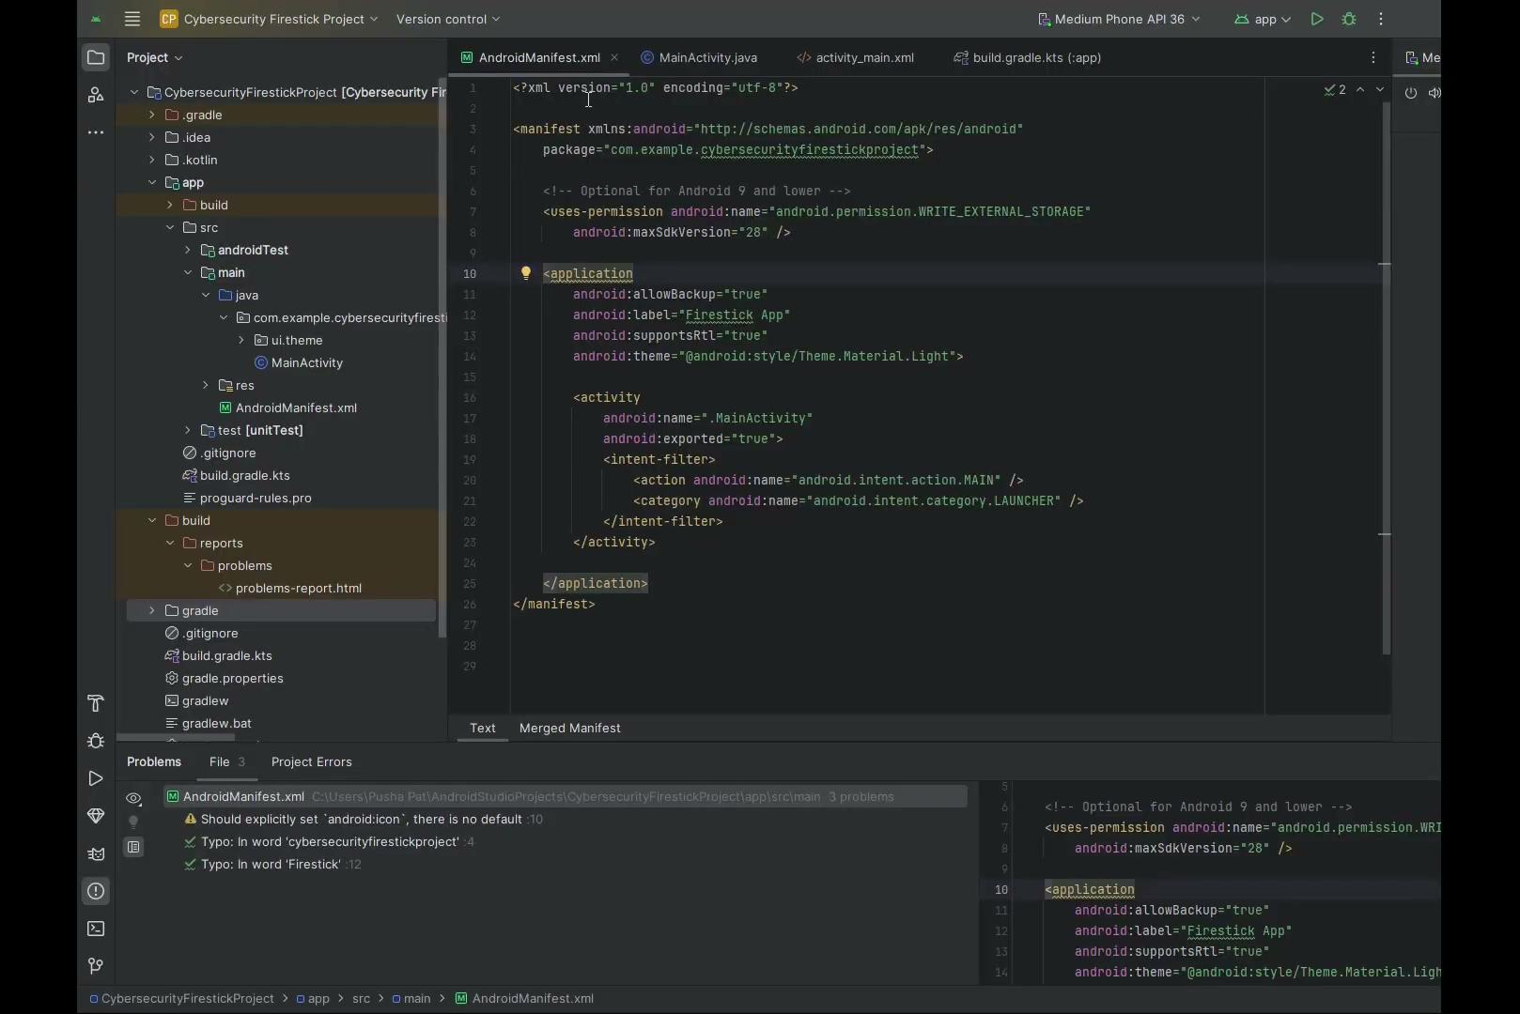
Notes:
Shantel

Slide 10
Demonstration Summary

Slide 11
The Afterburn:
A Firestick can provide a real-world environment to practice penetration testing, vulnerability scanning, and vulnerability exploitation techniques.. Even though it seems harmless, it’s crucial to recognize the potential hazards involved.
Unauthorized modifications to the Firestick software, including bypassing security features,violating Amazon’s Terms of Service. This can lead to account suspension, device bans, or loss of warranty.
Experimenting with exploits can lead to data corruption or even “bricking” your device. You might lose personal data, settings, or even render the Firestick unusable.
If your Firestick is connected to your home network, poorly designed exploits or network scanning tools could inadvertently expose other devices on your network.
Even in a controlled environment, you might accidentally expose sensitive data during your testing. For example, log files or network traffic captures could contain personal information.
If the exploitation is used to access paid content for free, such as bypassing Digital Rights Management (DRM), it could violate copyright laws under the Digital Millennium Copyright Act (DMCA).
Exploits can cause system instability, app crashes, or unexpected behavior. This can make your Firestick unreliable for regular use.
To perform ethical Firestick penetration testing, ensure that you can secure proper permissions and operate within legal boundaries. Unauthorized exploitation carries substantial legal and financial risks.
Notes:
TaSheria - Summary and impact of the exploit, describing some impacts of exploiting a FS

Slide 12
Mitigation

Slide 13

Stopping The Spread:
Purchase a Firestick from a trusted retailer.
Enable multi-factor authentication for added security.
If buying from a third party, perform a factory reset before use.
Keep ADB debugging disabled to prevent unauthorized access.
Avoid downloading apps from unverified sources.
Connect your Firestick only to trusted, encrypted Wi-Fi networks
Check for unknown devices connected to your Firestick under:
Settings > My Fire TV > About > Network
If you log into apps (like Netflix, Hulu, etc.), periodically log out to minimize stored session data.
If you suspect unauthorized access, reset the Firestick to factory settings:
Settings > My Fire TV > Reset to Factory Defaults
Notes:
Patrick
Purchase the Firestick device from a reputable and authorized retailer.
Enable multi-factor authentication to enhance account security.
If the device is acquired from a third party, perform a factory reset prior to use.
Keep ADB debugging disabled to reduce the risk of unauthorized access.
Refrain from installing applications from unverified or unknown sources.
Connect the Firestick only to secure, encrypted, and trusted Wi-Fi networks.
Regularly monitor for unfamiliar devices connected to your Firestick by navigating to: Settings > My Fire TV > About > Network
If you sign into applications such as Netflix, Hulu, or similar services, consider logging out periodically to limit stored session data.
If you suspect any unauthorized access, restore the device to its factory settings by going to: Settings > My Fire TV > Reset to Factory Defaults

Slide 14
Thank you

Slide 15


